Slide 1





FOR SALE
NYC REAL ESTATE
Notes:
I have been living in NYC now for coming up on 8 years now which involved multiple moves through the years. Anyone who does live here knows that the process of finding an apartment regardless if you are buying or renting is a taxing process. With NYCs 8.5M inhabitants apts are a scarcity therefore they move quick and being able to see an up to date list of available apartments is imperative to finding the new home. There are multiple apt real estate aggregators such as StreetEasy but they make it very difficult to scrape their data because that is the product they are selling. Therefore I opted to focus on a specific brokerage firm, Corcoran(Cockran). They are a large real estate firm in NYC with listings over all the 5 boros and this project provides a snapshot of the inventory available and an analysis of the market that Corcoran markets to. I utilized the selenium package because after inspecting the search results the website utilizes ajax applications which makes it difficult and inefficient to scrape with beautiful soup or scrapy.

Slide 2
Raw Data
MANHATTAN
BROOKLYN
Notes:
For my project I had two scrapes pulling the address, neighborhood, price, apt type(Condo/co op/townhouse), number of bedrooms, bathrooms, total rooms, sqft, and a description for each listing they had in each boro. I scraped all 1317 listings for Manhattan and 553 listings for BK they had. For cleaning the data I had to removed $ and , from the price as well as change the types to an integer to be able to perform analysis on it. Unfortunately each of their listings are not complete, using averages or interpolation would not be appropriate so I only used complete listings with data for all keys for my analysis. However each listing did include a description so for my word cloud analysis I used the total catalog of listings. The result was a set of listings for Manhattan with 690 listings and BK of 302. Ill go into details for each boro in the following slides.

Slide 3
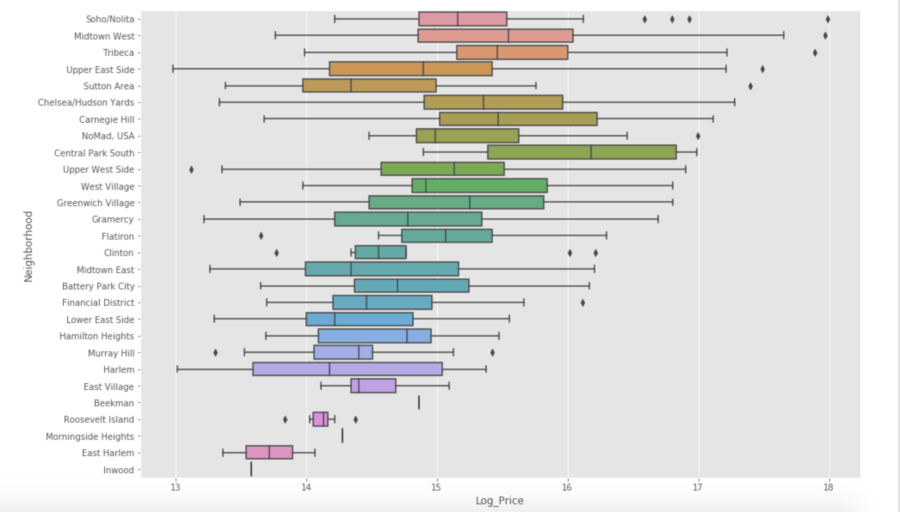
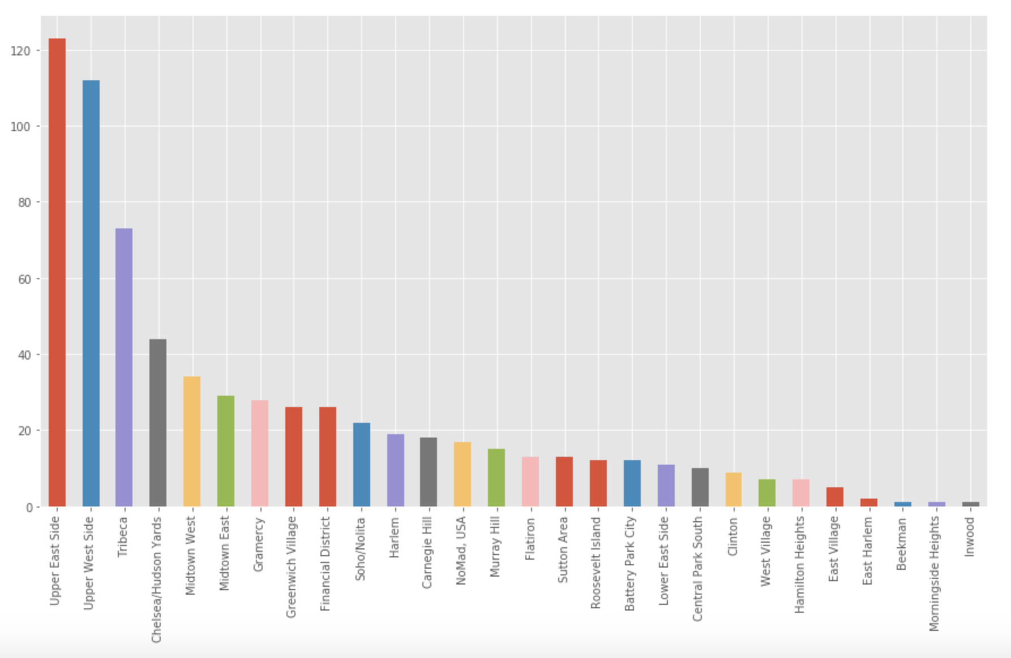
Manhattan
Notes:
-There are 28 unique neighborhoods in Manhattan
-Manhattan contains listings for apts from 1 bedroom apts or studios up with sq ft of 500sq feet(possibly smaller just not listed, not great selling point) to 12 bed mansion apts up to 14000+ sq feet.
-The average available Manhattan apt is a 2.6Bed, 2.7bath, 2200sqft apt for 5.4M, these figures are driven up by a group of ultra luxe outlier apts including the most expensive apt in their listings the 65M penthouse on Broome st in Nolita/Soho
-The first box plot shows the distribution of price for apartments in each of the 28 Manhattan neighborhoods. It is visible from the graph that all the neighborhoods in Manhattan are not created equal and that among other factors location is a driver of price. Also visible are outliers for each neighborhood which drives up averages as well shows that relatively pricey apartments are available in a multitude of apts.
array(['Soho/Nolita', 'Midtown West', 'Tribeca', 'Upper East Side', 'Sutton Area', 'Chelsea/Hudson Yards', 'Carnegie Hill', 'NoMad, USA', 'Central Park South', 'Upper West Side', 'West Village', 'Greenwich Village', 'Gramercy', 'Flatiron', 'Clinton', 'Midtown East', 'Battery Park City', 'Financial District', 'Lower East Side', 'Hamilton Heights', 'Murray Hill', 'Harlem', 'East Village', 'Beekman', 'Roosevelt Island', 'Morningside Heights', 'East Harlem', 'Inwood'], dtype=object)
Neighborhood Neighborhood Battery Park City 12 Beekman 1 Carnegie Hill 18 Central Park South 10 Chelsea/Hudson Yards 44 Clinton 9 East Harlem 2 East Village 5 Financial District 26 Flatiron 13 Gramercy 28 Greenwich Village 26 Hamilton Heights 7 Harlem 19 Inwood 1 Lower East Side 11 Midtown East 29 Midtown West 34 Morningside Heights 1 Murray Hill 15 NoMad, USA 17 Roosevelt Island 12 Soho/Nolita 22 Sutton Area 13 Tribeca 73 Upper East Side 123 Upper West Side 112 West Village 7

Slide 4
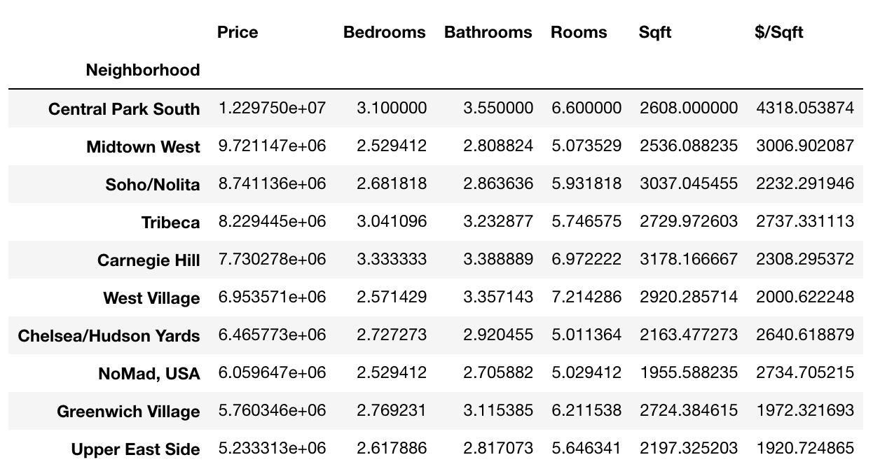
MANHATTAN NEIGHTBORHOODS
Notes:
I wanted to provide a snapshot of the top 10 avg price neighborhoods. Central Park South has the highest avg price apts in Manhattan from the data provided. Averaging $12M vs the boro average of $5M, the apartments are larger 3 bedrooms 3.5 bathroom 2600sq feet apartments. Many of these apartments offer CP views which will naturally drive these prices up. Billionaires row on 57th st is also located in CPS which will drive average prices up.

Slide 5
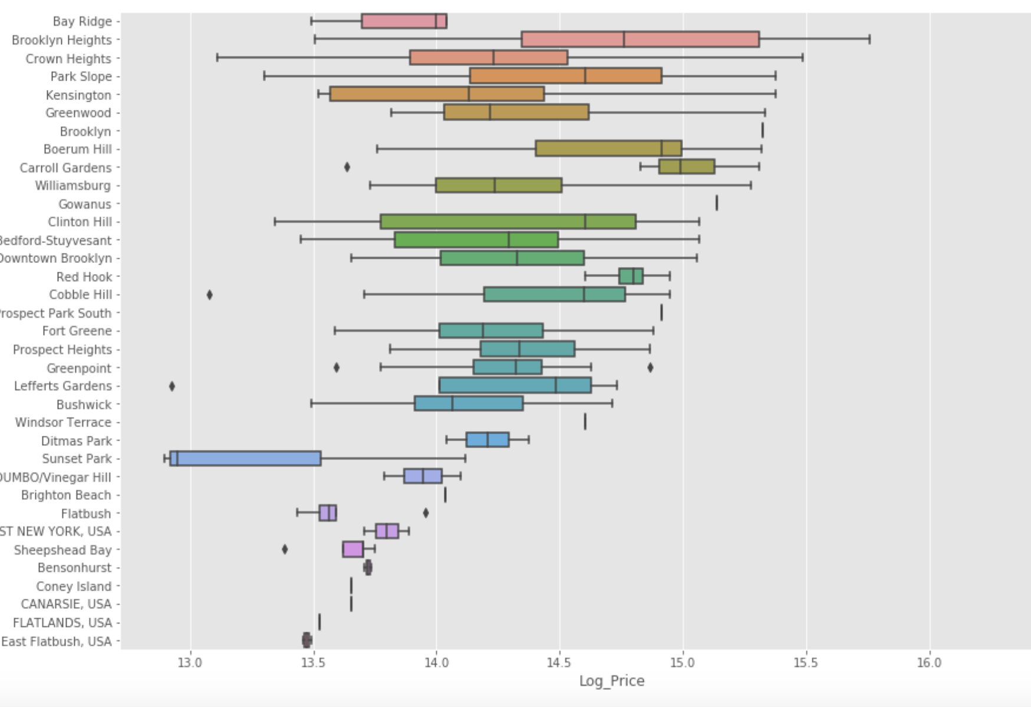
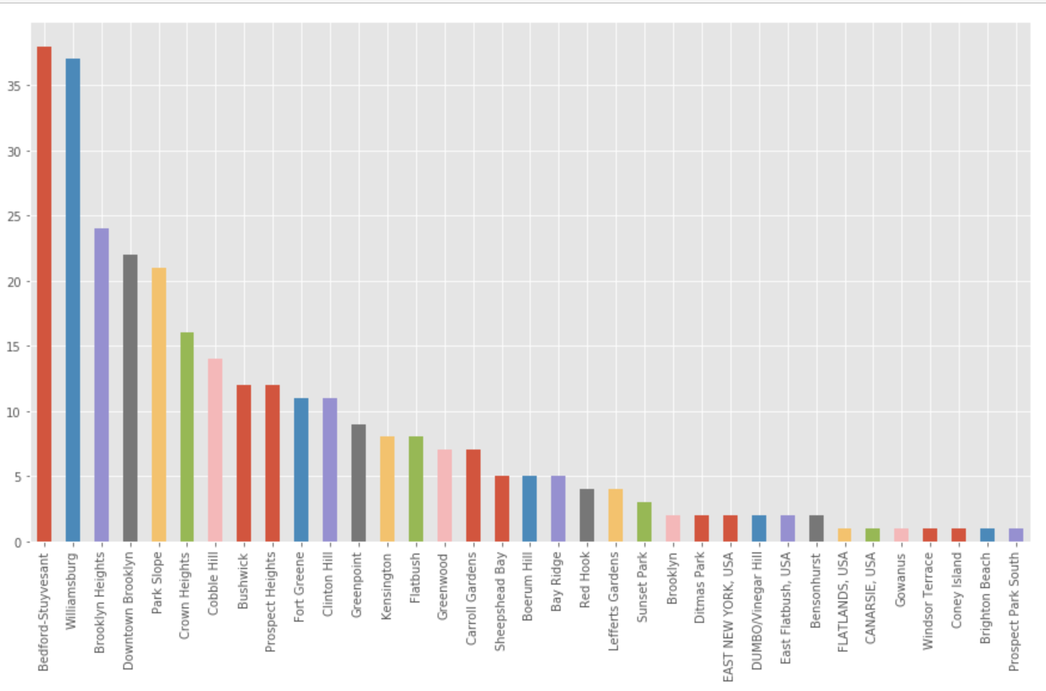
Brooklyn
Notes:
-BK and its 70 sq miles is 3 times the size of Manhattan and contains 31 distinct neighborhoods
-As a boro the average available apt is 3.7Bed, 2.8 bath, 2070 sqft apt.
-Its interesting that both Bed Stuy and Williamburg are the two higest neighborhoods looking to sell which are both on the L line which is shutting down in April and a major issue for commuting into manhattan from those neighborhoods
Neighborhood Bay Ridge 5 Bedford-Stuyvesant 38 Bensonhurst 2 Boerum Hill 5 Brighton Beach 1 Brooklyn 2 Brooklyn Heights 24 Bushwick 12 CANARSIE, USA 1 Carroll Gardens 7 Clinton Hill 11 Cobble Hill 14 Coney Island 1 Crown Heights 16 DUMBO/Vinegar Hill 2 Ditmas Park 2 Downtown Brooklyn 22 EAST NEW YORK, USA 2 East Flatbush, USA 2 FLATLANDS, USA 1 Flatbush 8 Fort Greene 11 Gowanus 1 Greenpoint 9 Greenwood 7 Kensington 8 Lefferts Gardens 4 Park Slope 21 Prospect Heights 12 Prospect Park South 1 Red Hook 4 Sheepshead Bay 5 Sunset Park 3 Williamsburg 37 Windsor Terrace 1 dtype: int64
-array(['Bay Ridge', 'Brooklyn Heights', 'Crown Heights', 'Park Slope', 'Kensington', 'Greenwood', 'Brooklyn', 'Boerum Hill', 'Carroll Gardens', 'Williamsburg', 'Gowanus', 'Clinton Hill', 'Bedford-Stuyvesant', 'Downtown Brooklyn', 'Red Hook', 'Cobble Hill', 'Prospect Park South', 'Fort Greene', 'Prospect Heights', 'Greenpoint', 'Lefferts Gardens', 'Bushwick', 'Windsor Terrace', 'Ditmas Park', 'Sunset Park', 'DUMBO/Vinegar Hill', 'Brighton Beach', 'Flatbush', 'EAST NEW YORK, USA', 'Sheepshead Bay', 'Bensonhurst', 'Coney Island', 'CANARSIE, USA', 'FLATLANDS, USA', 'East Flatbush, USA'], dtype=object)

Slide 6
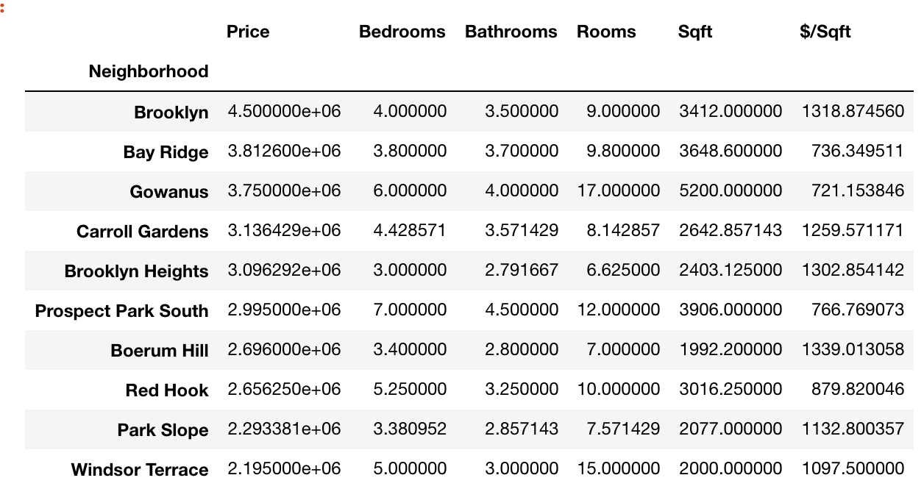
Brooklyn Neighborhoods
Notes:
Where the last graph showed inventory by neighborhood, here were showing the top 10 priciest neighborhoods in BK. Now the first neighborhood is mislabeling by the firm because the whole boro is BK and not one neighborhood. Something that is interesting though looking at this, none of these price/sqft come close to the price of the top 10 neighborhoods in Manhattan. The cost of living on the island with its limited space is at a premium

Slide 7
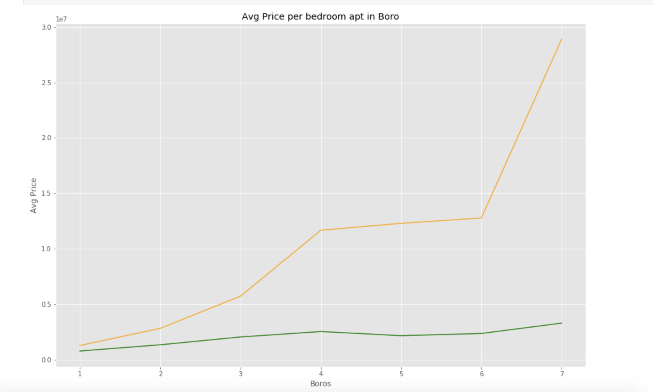
Manhattan v Brooklyn
 | Manhattan | Brooklyn
Avg Price | $ 5,414,923 | $ 1,938,495
Max Price | $ 65,000,000 | $ 15,000,000
Min Price | $ 435,000 | $ 400,000
Max Sqft | 14,539 | 10,010
Avg Sqft | 2,203 | 2,070
Max Rooms | 25 | 36
Avg Rooms | 5.52 | 7.45
Max Bedrooms | 12 | 12
Avg Bedrooms | 2.65 | 3.65
Avg Price Per Sq ft | $ 2,121 | $ 1,007
Notes:
-This is our side by side comparisons of the inventory in both neighborhoods and a graph showing the avg price per bedroom for each of the neighborhoods
I also included a visual graph to show the average price per bedroom per boro. As expected Manhattans real estate in Manhattan is more expensive than BK but the margin seems to grow as the bedrooms grow.

Slide 8
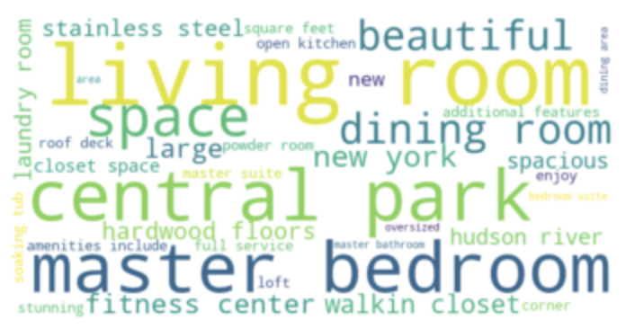
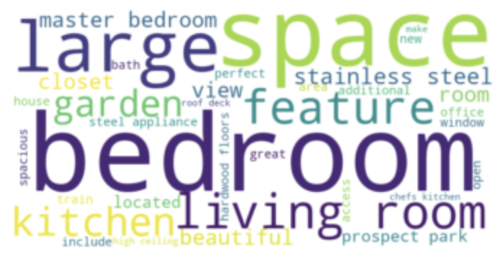
Manhattan v Brooklyn
Notes:
Lastly the comparison I wanted to look at is the verbiage used by brokers to try to market their apartments and if there were any differences between the boros. I used the description columns, and therefore I was able to use all 1300+ Manhattan listings and 600 BK listings. After I ran the word cloud the initial time many words that you would have expected to show up in listings, ('well', 'unit', 'offer', 'throughout', 'new york', 'home', 'apartment', 'building’) showed up so I added them to the stop list and reran. There were bound to overlaps between some of the boros but what caught my eye was in Manhattan locations and proximity to other destinations were included in many listings such as Central Park and Hudson River. On the other side for Brooklyn garden and space popped out to me because as Manhattan is more expensive per sq ft and space is more of a luxury having a garden in BK is a sought out feature. And as one looking to move to BK outdoor space is one of the things that I'm personally looking for, though more of a roof deck than garden.

Slide 9

QUESTIONS
-Going Forward
-Including a shiny app where you can select a neighborhood and it will provide neighborhood details as well box plot analysis
-Also you could run this daily and see which neighborhoods are added to the market by use of a dictionary
Notes:
Going forward
With Shiny all my neighborhood specific graphs could be interactive and you can change the neighborhood in a pull down of see a box plot analysis of that neighborhood instead of the one I specified.
Also if you did pull daily you could see which apartments are new to the market and which ones are unavailable if you commit everything to a dictionary

